Slide 1
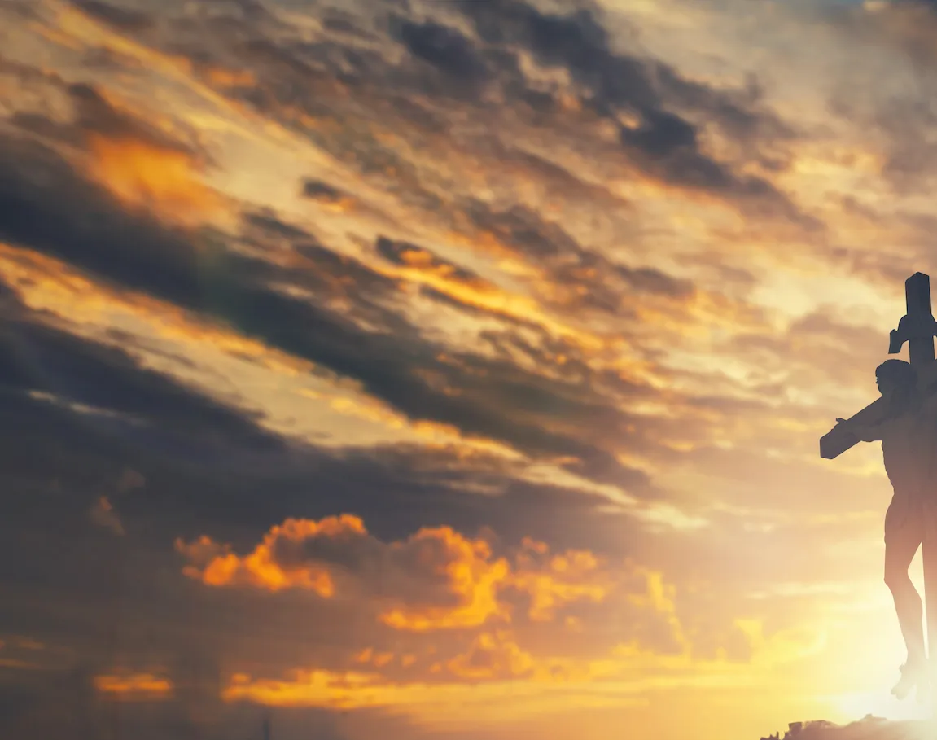
Above All

Slide 2
CAPO 2nd
C D G
Above all powers, above all Kings
C D G
Above all nature, and all created things
Em D C G
Above all wisdom, and all the ways of man
Am D G
You were here before the world began

Slide 3
C D G
Above all kingdoms, above all thrones
C D G
Above all wonders this world has ever known
Em D C G
Above all wealth and treasures of the earth
Am C B
There's no way to measure what You're worth

Slide 4
G Am D G
Crucified, laid behind a stone
G Am D G
You lived to die, rejected and alone
Em D C G
Like a rose, trampled on the ground
Am G C D G
You took the fall, and thought of me Above all

Slide 5
C D G
Above all powers, above all Kings
C D G
Above all nature, and all created things
Em D C G
Above all wisdom, and all the ways of man
Am D G
You were here before the world began

Slide 6
C D G
Above all kingdoms, above all thrones
C D G
Above all wonders this world has ever known
Em D C G
Above all wealth and treasures of the earth
Am C B
There's no way to measure what You're worth

Slide 7
G Am D G
Crucified, laid behind a stone
G Am D G
You lived to die, rejected and alone
Em D C G
Like a rose, trampled on the ground
Am G C D G
You took the fall, and thought of me Above all
Play x2

Slide 8
Em D C G
Like a rose, trampled on the ground
Am G C D G
You took the fall, and thought of me Above all
END

